Slide 1
SNS ACADEMY
COURSE NAME : Computer Systems and Organisation
GRADE 11 TH
Topic 1 : Number System

Slide 2
NUMBER SYSTEM
Types of number system:
There are various types of number system which as follows:
Binary Number System (base 2)
Octal Number System (base 8)
Decimal Number System (base 10)
Hexadecimal Number System (base 16)

Slide 3
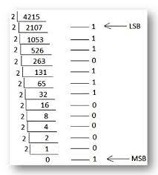
Decimal Into Binary

Slide 4
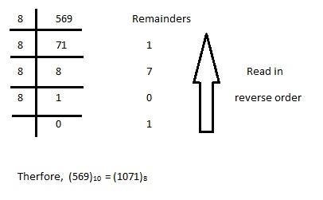
Decimal Into Octal

Slide 5
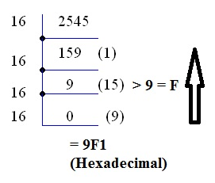
Decimal Into Hexa decimal

Slide 6
Binary To Decimal

Slide 7
Binary To Decimal
What is the answer for 00111?

Slide 8
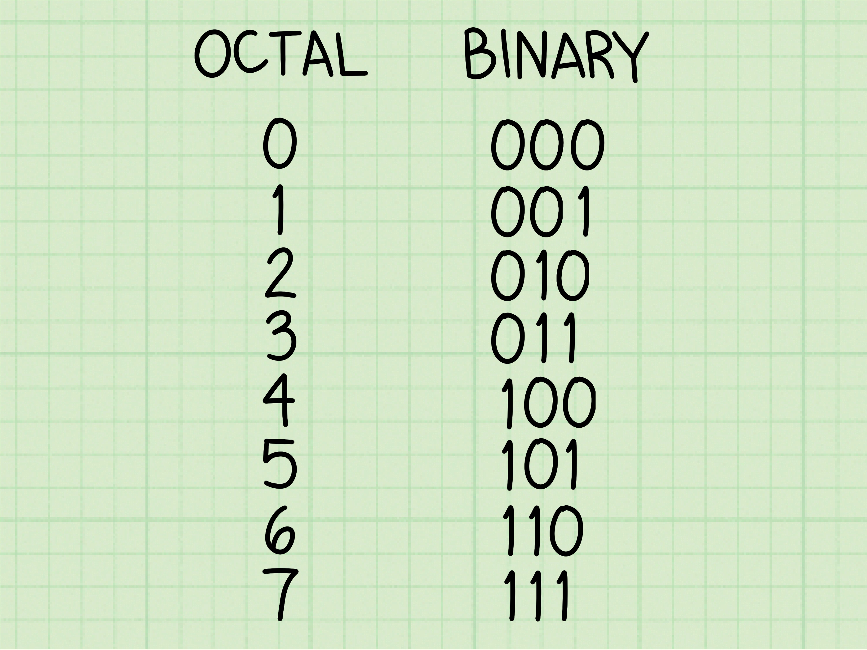
Binary To Octal

Slide 9
Binary To Octal
What is the answer for 110101?

Slide 10
Binary To Octal

Slide 11
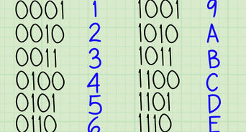
Binary To Hexa decimal

Slide 12
Binary To Hexadecimal
What is the answer for 0100110111010000 ?

Slide 13
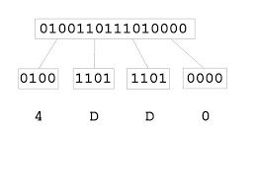
Binary To Hexadecimal
Answer 4DD016

